Slide 1
New Mexico Work & $ave Research Kim Olson The Pew Charitable Trusts New Mexico Retirement Savings Symposium September 20, 2022
1

Slide 2
Auto-IRAs and market for retirement plans
Competitive or complementary?
Auto-IRAs ‘nudging’ employers to adopt plans?
Are employers dropping their benefits?
Analysis of Form 5500 filings, 2013-2020, with focus
on CA, IL, OR
Notes:
e.g., in PA: the ratio of elderly households to working age households, will increase by 48% over 15 years
Finding on retirement savings participation have largely not changed in 40 years
Increased spending on Medicaid and state-sponsored programs like low-income heating assistance
Reduced economic activity and depressed tax revenues due to increase in vulnerable older households

Slide 3
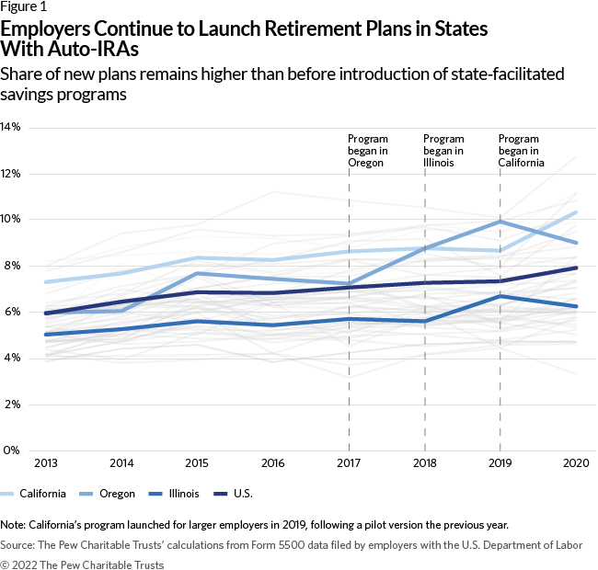
Are auto-IRAs ‘nudging’ employers to adopt plans?
Bump in new plans after auto-IRAs go into effect

Slide 4
CalSavers begins

Slide 5
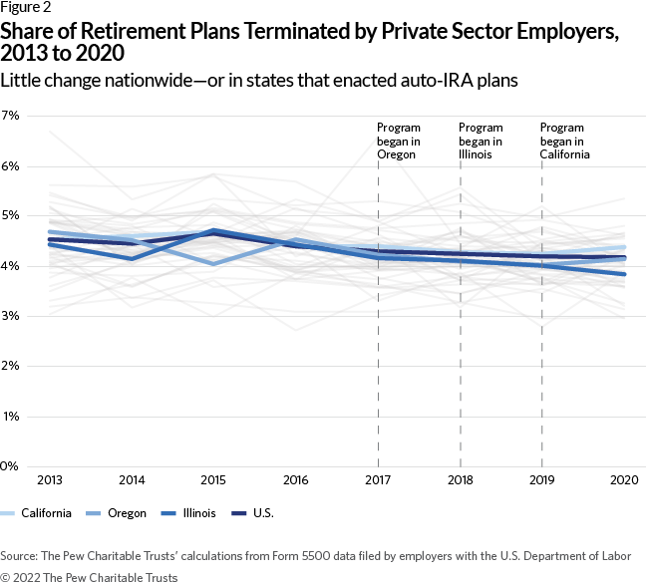
Are employers dropping their retirement plans?
Plan terminations in auto-IRA states not different from other states, US average

Slide 6
Current program vs. Auto-IRA comparison
Modeled two approaches:
Employer voluntary registration, employee opt-out IRA program
Employer required registration, employee opt-out IRA program
Used assumptions to project when the program will become:
1) Cash-flow positive (state’s fee revenue exceeds state costs; program is self-sustaining)
2) Net positive (state’s fee revenue exceeds state’s collective costs)

Slide 7
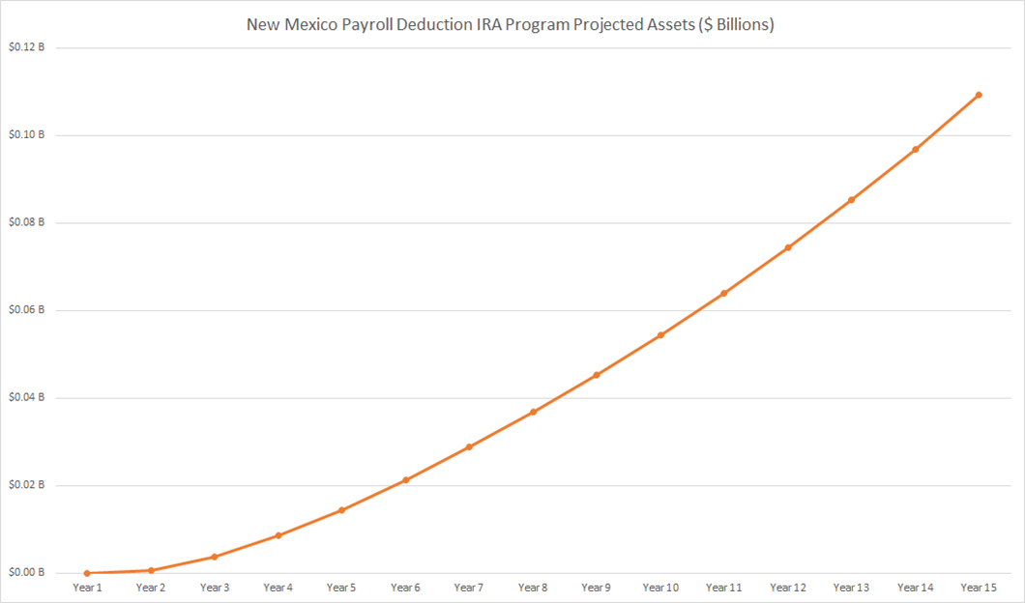

Slide 8
